Slide 1
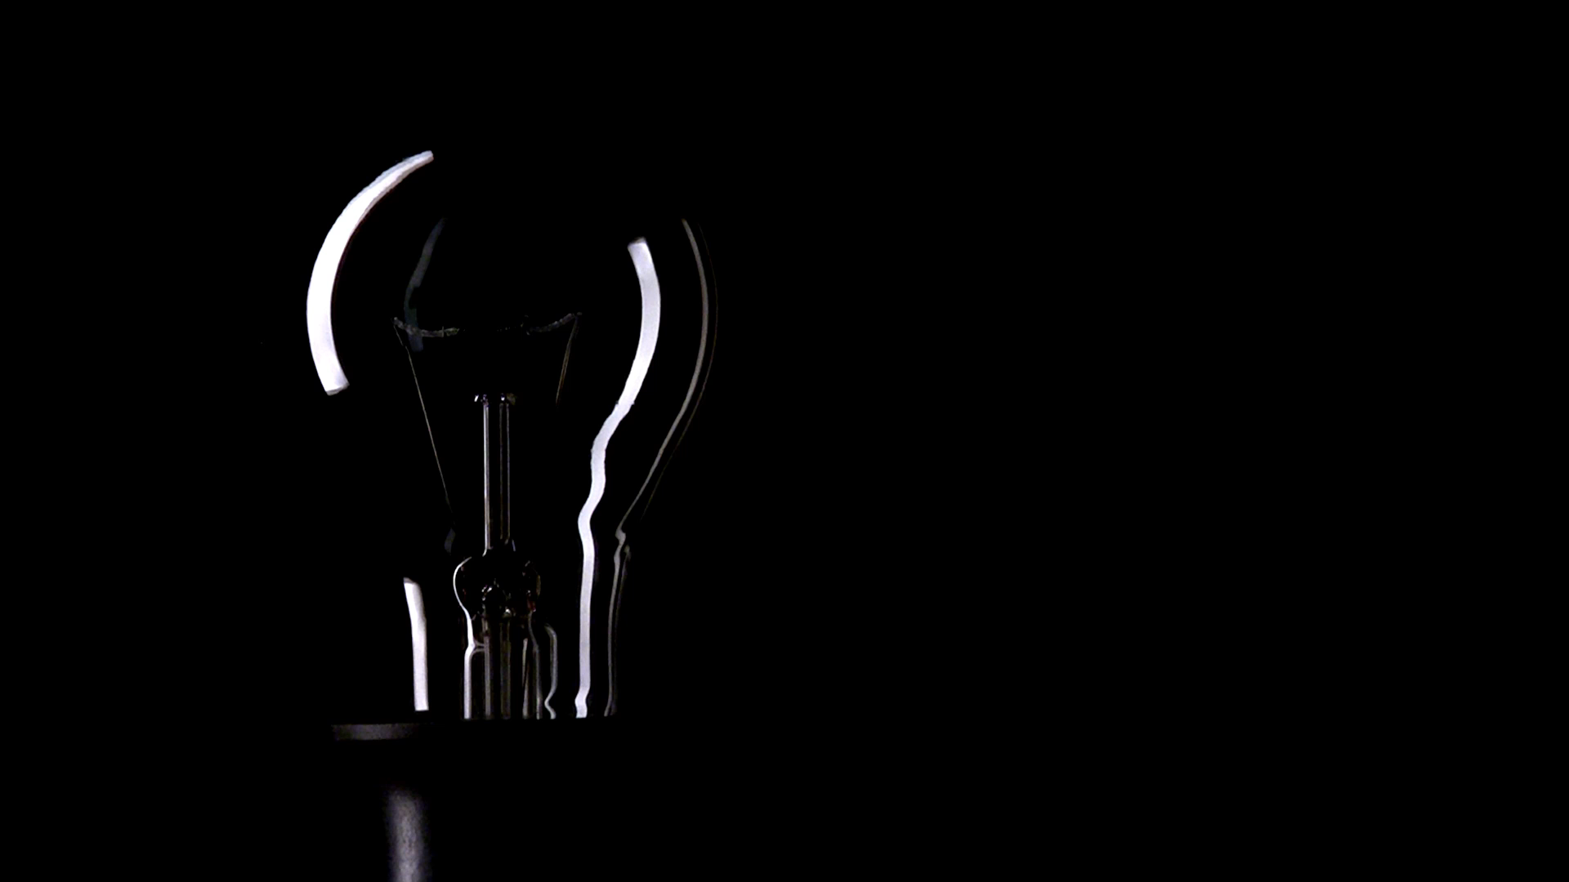
Light Tracking System
ECE558 Final Project
Neima Kashani & Abhijeet Prem

Slide 2
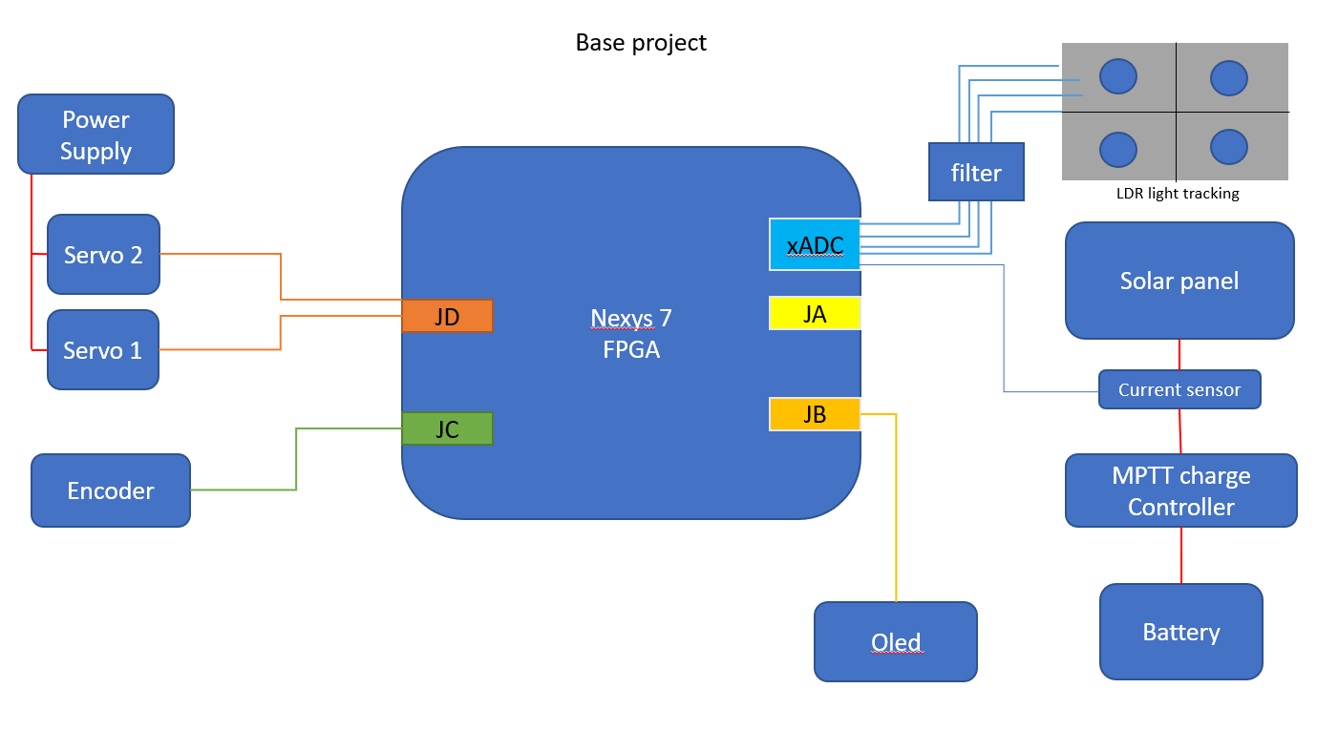
Overview
Base project:
A system capable of tracking the light source in 2 axis using Light Dependent Resistor (LDR)
The control system will be implemented using FPGA
Able to set and reset the position using encoder and switches
Display the parameters on the OLED display
PWM

Slide 3
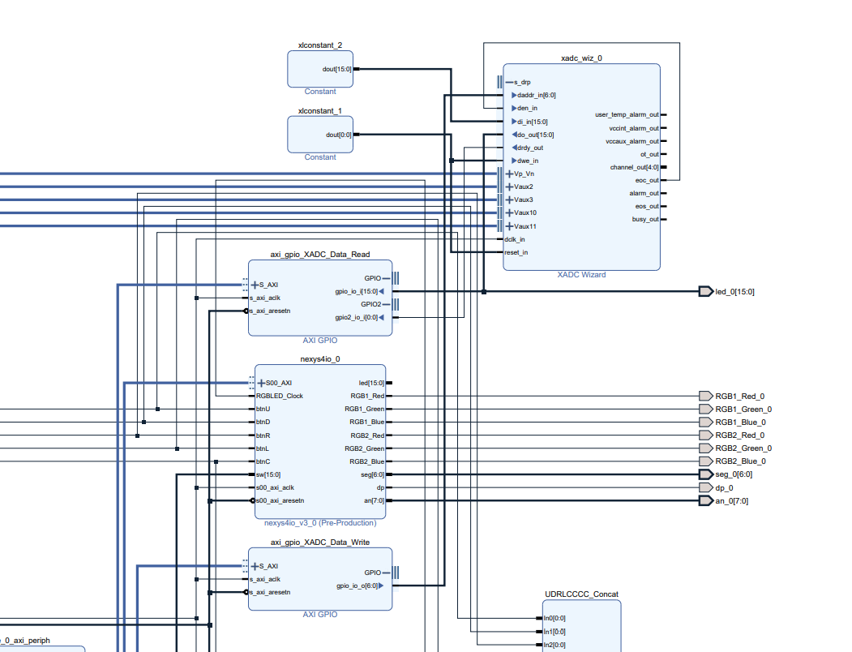
Hardware implementation

Slide 4
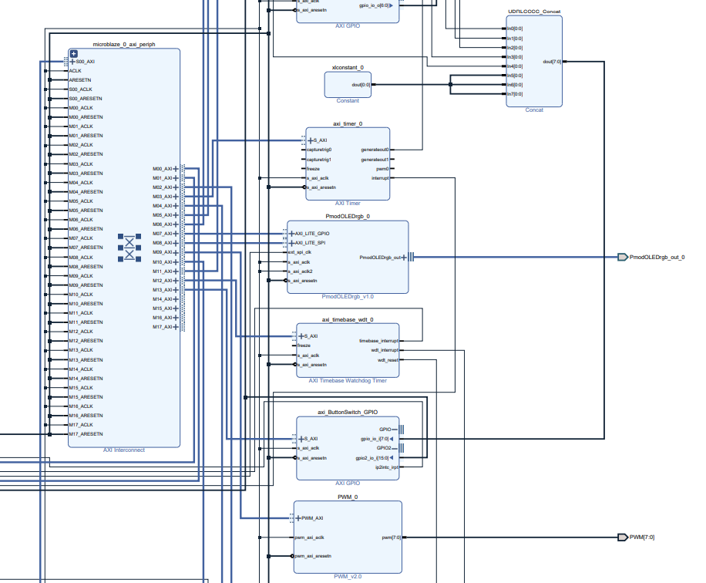

Slide 5
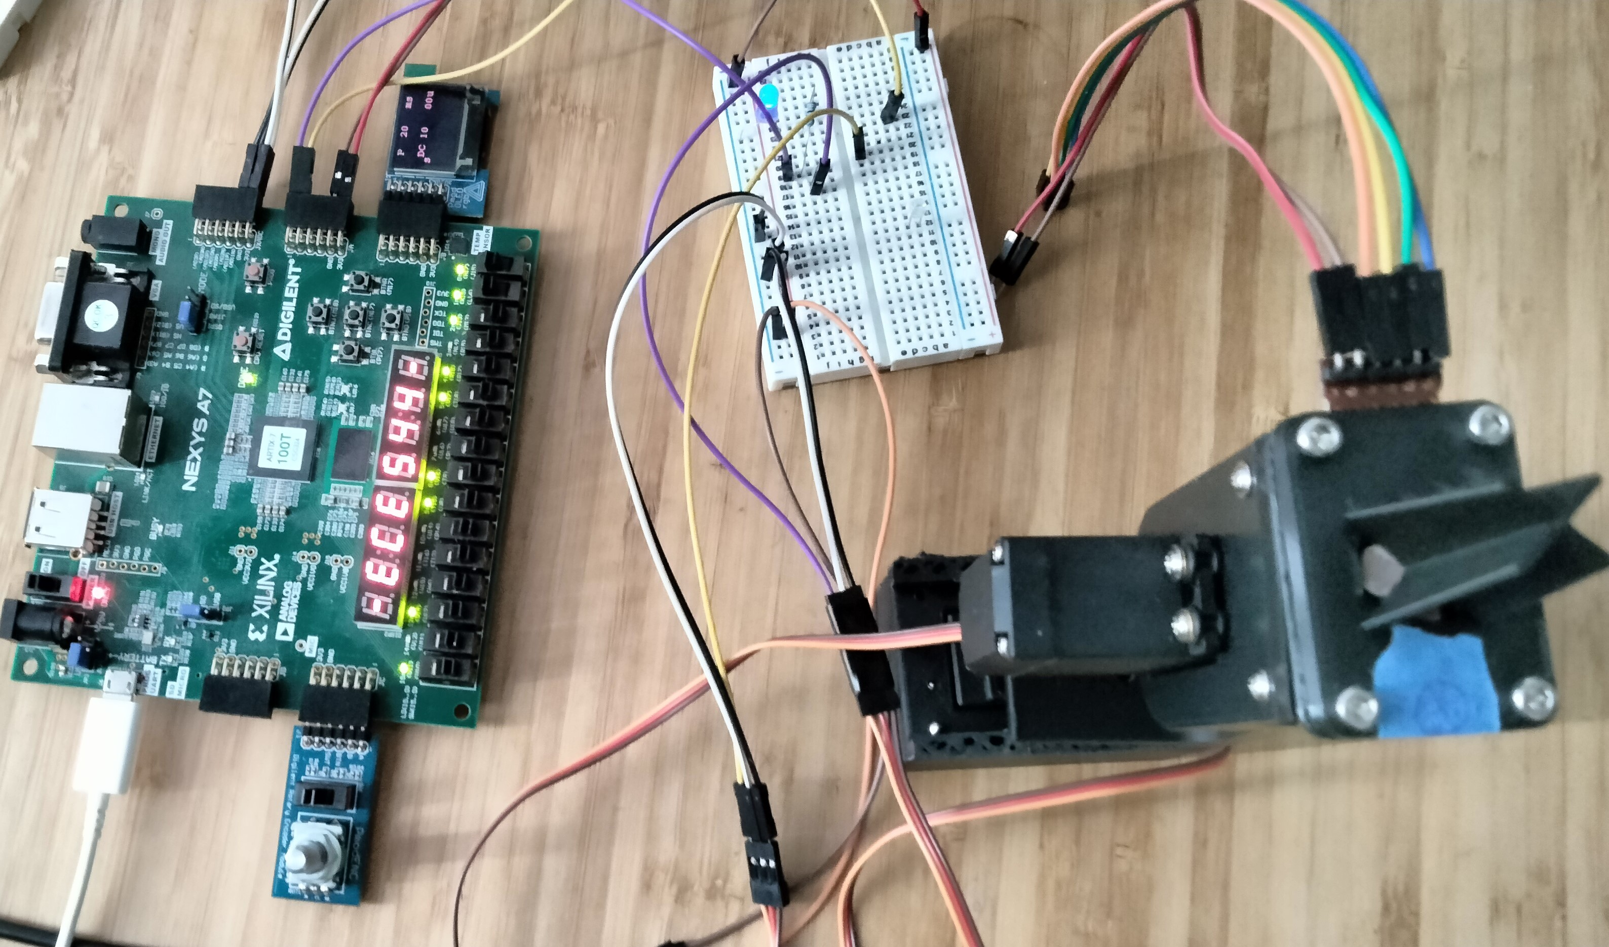
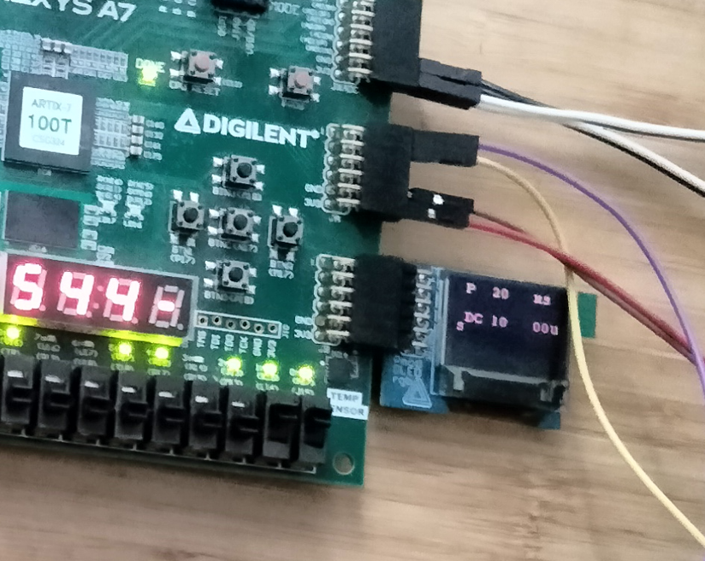
System overview

Slide 6
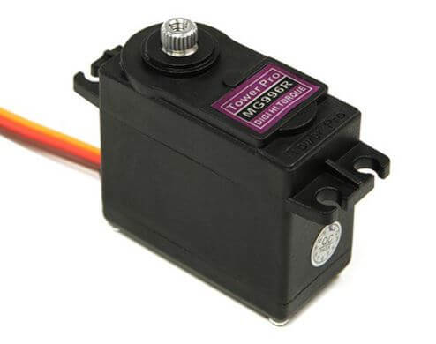
Controlling servo – Hardware
Uses PWM signals to command the angle
Period 20ms
Duty -2.5% to 11%
2.5% mapped to 0 degrees
11% mapped to 180 degrees

Slide 7
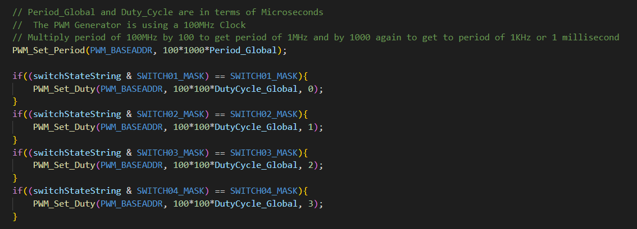
Controlling servo – Firmware

Slide 8
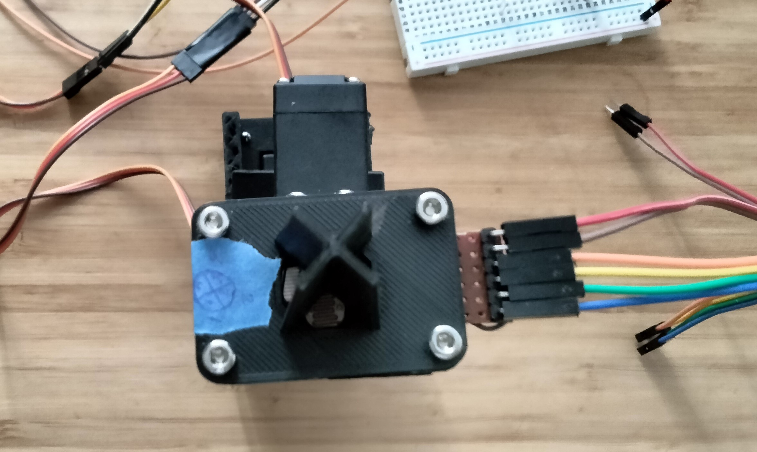
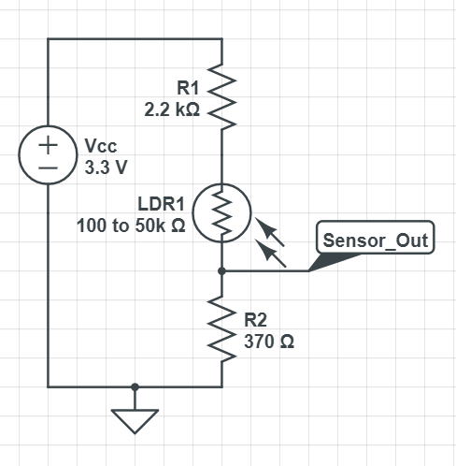
LDR tracking – Hardware
Sensor network is a voltage divider circuit
Had to limit the upper bound to 1V
The xADC cannot take voltage beyond 1V
The module acts as a Pmod too
Directly plug into the xADC port for Debugging

Slide 9
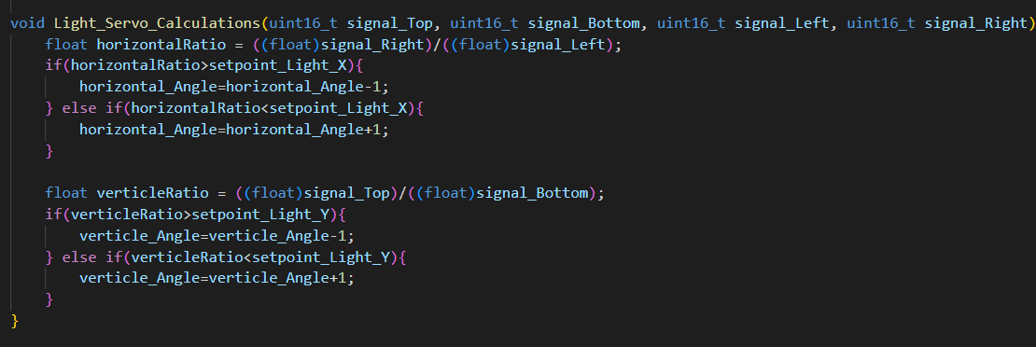
LDR tracking – Firmware

Slide 10
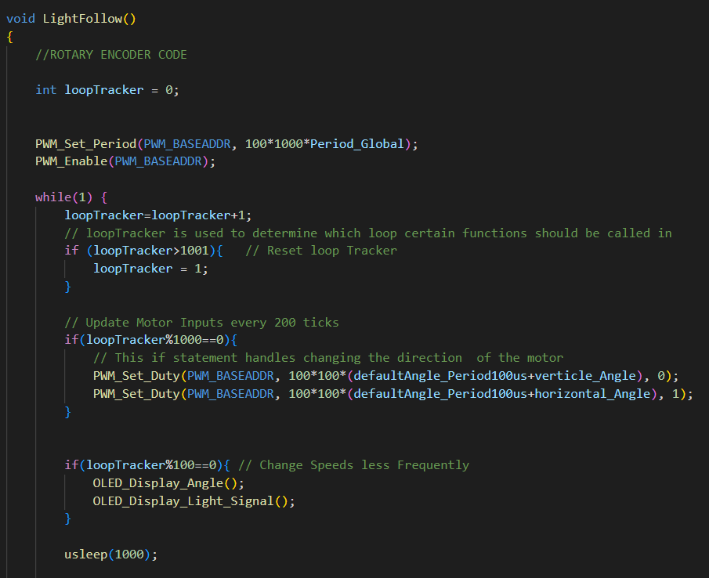
LDR tracking – Firmware

Slide 11
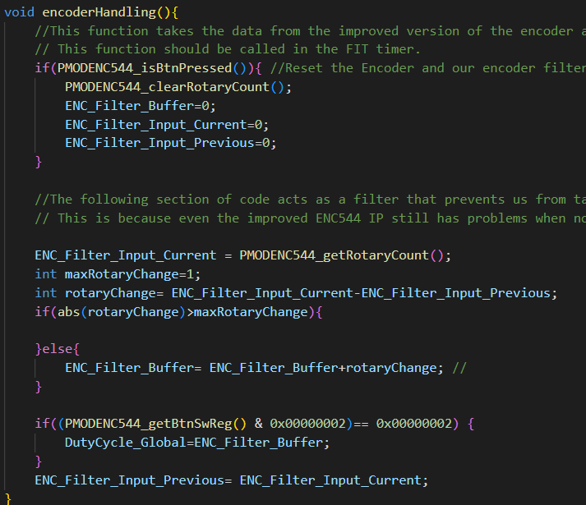
Encoder – firmware

Slide 12
What’s working so far:
Able to set the parameters for PWM control:
Can take encoder reading successfully
Use switches and push buttons to set the parameters
Able to control the servos manually – barely
Print debug parameters on the OLED display
Interface xADC at hardware level – having trouble in reading

Slide 13

Demo – video
link

Slide 14
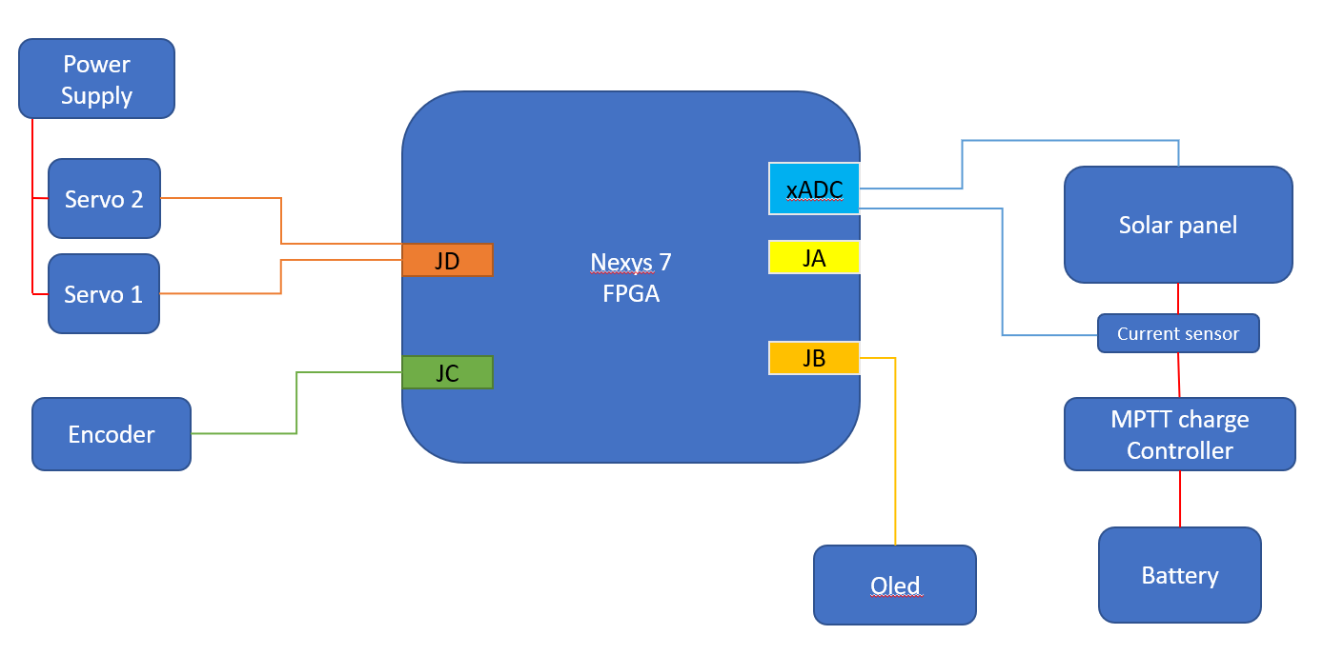
Stretch goals
Interfacing the solar charging unit to the base system.
Able to track the light source using the solar cells itself
We could’t get the xadc to properly work, so was working on debugging the issue

Slide 15
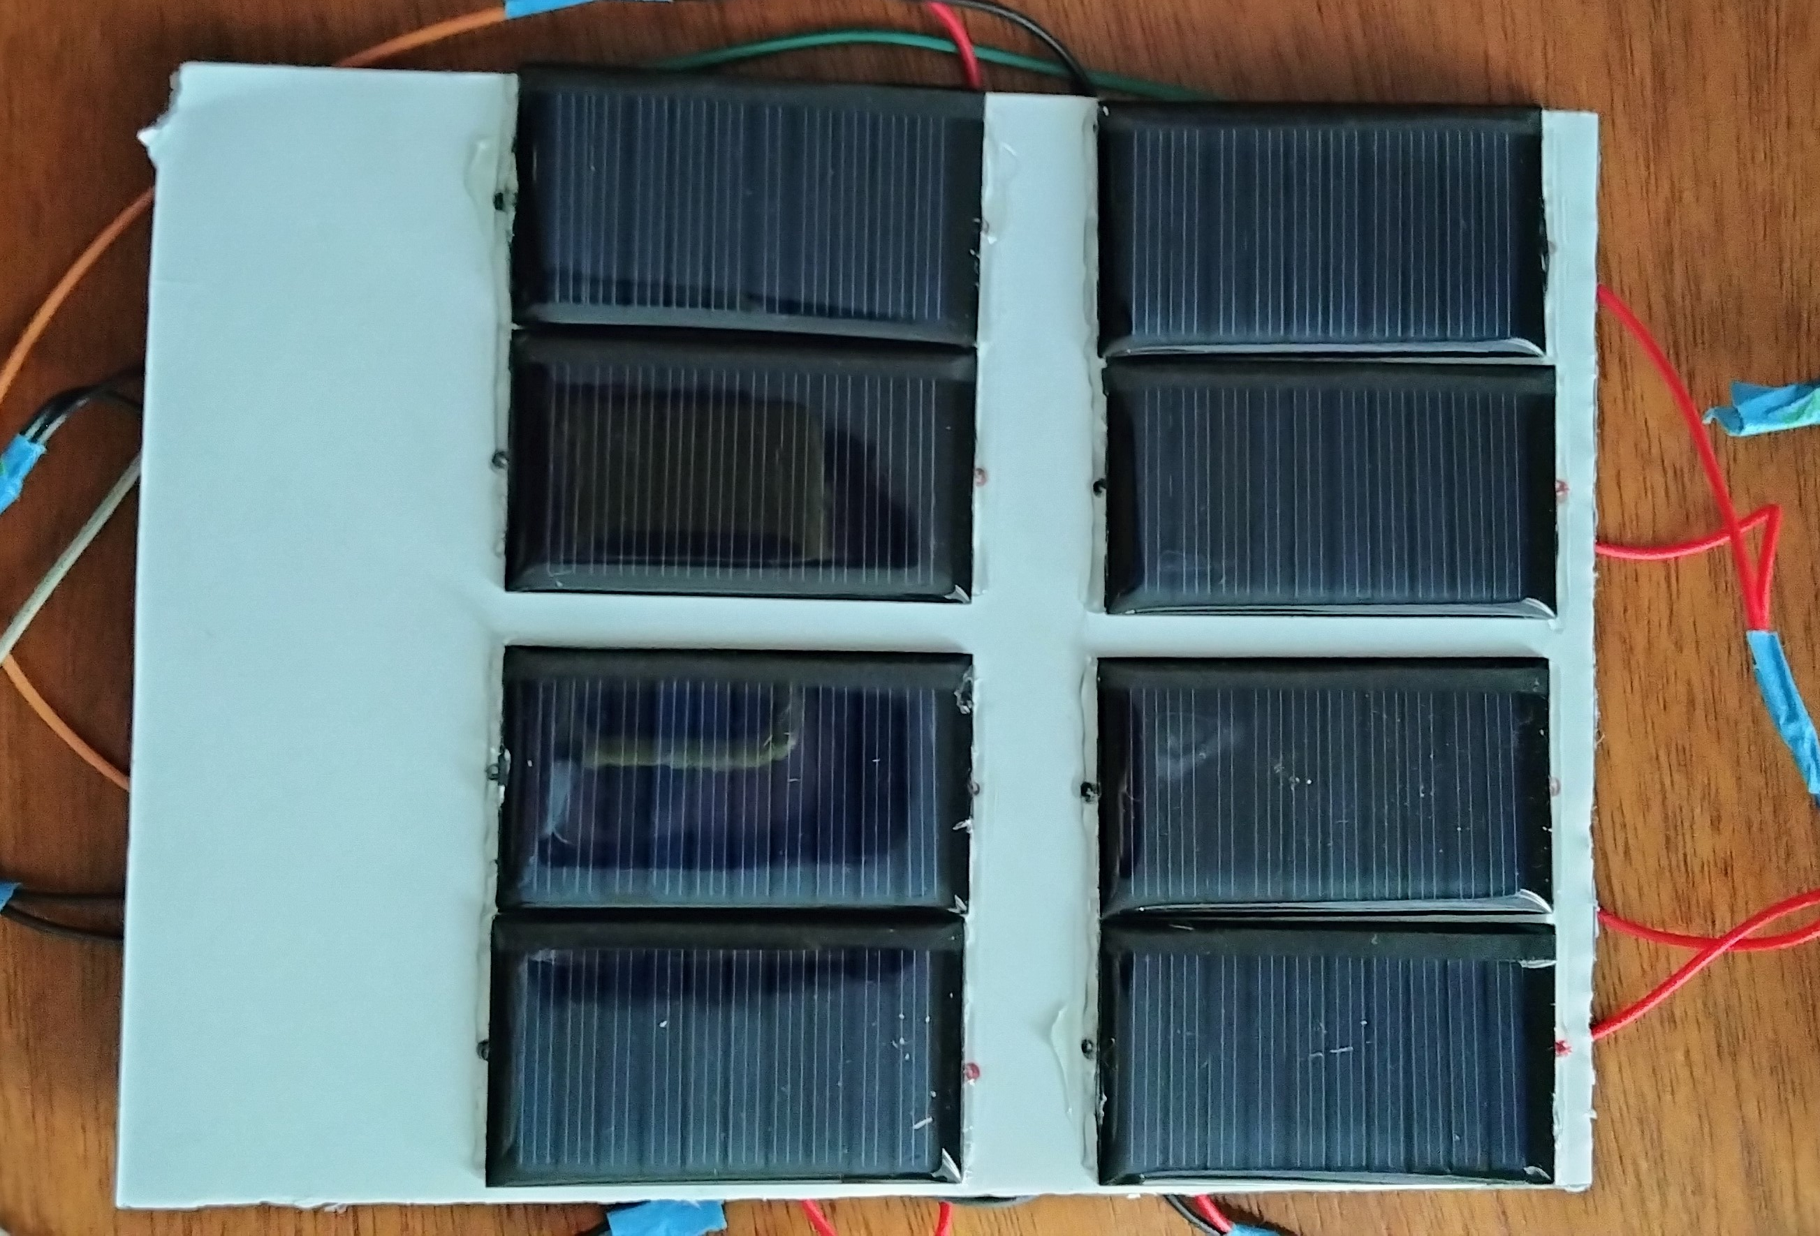
Custom panel

Slide 16
Final thoughts
The good:
We were able to get the Servo system running
Use the encoder and switches to set the parameters
Get the xADC interfaced on hardware implementation
Issues and problems:
Got behind schedule getting things done
Backup ADC came it late
Issue with getting the xADC interfaced
The servo sometimes goes haywire and starts rotating continuously
Need to make the firmware more robust
Circuit is not complete
We can manually control the servo

